Slide 1




ORIENTATION
Version 2.0

Slide 2


Acknowledgement
of Country
I would like to acknowledge the traditional custodians of this land.
I pay my respects to the Elders past, present and emerging.
For they hold the memories, the traditions and the culture of Aboriginal and Torres Strait Islander people across the nation.
Notes:
For Melbourne campuses, this is the Wurundjeri people

Slide 3

Overview of Orientation
Welcome to SCEI
Policies and procedures
Accessing student emails and MySCEI
Campus Tour
Meet and Greet with CC and Trainer
Work Placement requirements and documents – Work Placement Officer
Q&A

Slide 4
Mission Statement
To deliver education using innovative ​
approaches in a supportive environment; ​
to equip our students with knowledge and practical skills that will enable them to be active members of the wider community and future leaders in their chosen field.

Slide 5
Values
Academic Freedom of Inquiry & Opinion
Excellence
Accountability
Inclusivity
Partnership
Communities

Slide 6
General Information
155 Boundary Road, North Melbourne Campus
Reception Opening Hours:
Monday to Friday 8:30 am – 4:30 pm
Classes:
Monday – Friday 9:00 am – 4:00 pm
Email:
reception@scei.edu.au
41 Boundary Road, North Melbourne Campus
Reception Opening Hours:
Monday to Friday 8:30 am – 4:30 pm
Classes:
Monday – Friday 9:00 am – 4:00 pm
Email:
reception@scei.edu.au
14 – 16 Grote Street, Adelaide
Reception Opening Hours:
Monday to Friday 8:30 am – 4:30 pm
Classes:
Monday – Friday 9:00 am – 4:00 pm
Email:
reception_sa@scei.edu.au

Slide 7
Contacting SCEI
Student Administration Records​
Online@scei.edu.au
​
Melbourne Student Support Services
Welfare.melbourne@scei.edu.au ​
​
Adelaide Student Support Services
Welfare.adelaide@scei.edu.au ​
​
Student Financial Services
Accounts@scei.edu.au ​
​
Reception - Melbourne
Reception@scei.edu.au
Reception - Adelaide
Reception_sa@scei.edu.au
Work Placement Officer Contacts
Nursing.placements@scei.edu.au
Communitysector.placements@scei.edu.au
Earlychildood.placement@scei.edu
Pathology.placements@scei.edu.au
Agedcareandisability.placements@scei.edu.au
Note:
Please navigate to Student Services in MySCEI Moodle for specific areas of support

Slide 8


CAMPUS INFORMATION AND LIVING IN ADELAIDE

Slide 9



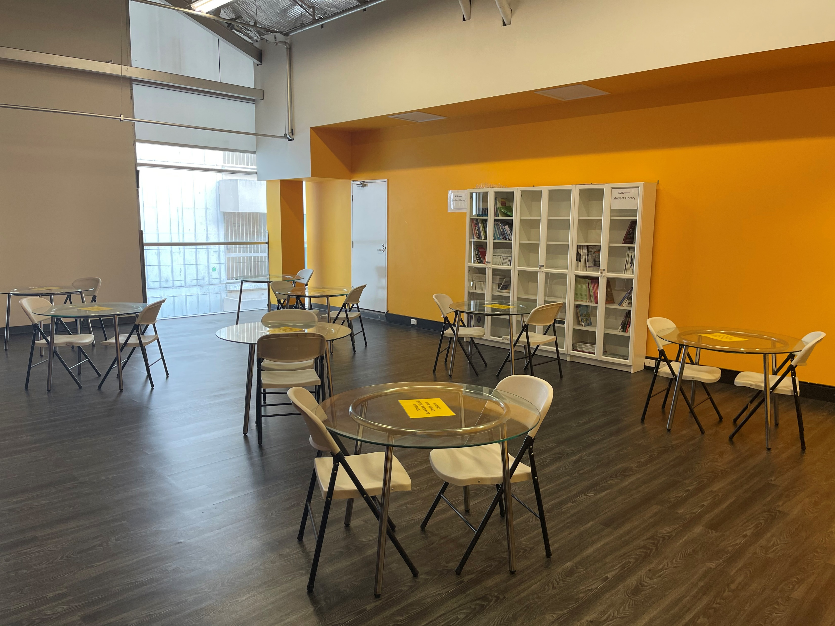
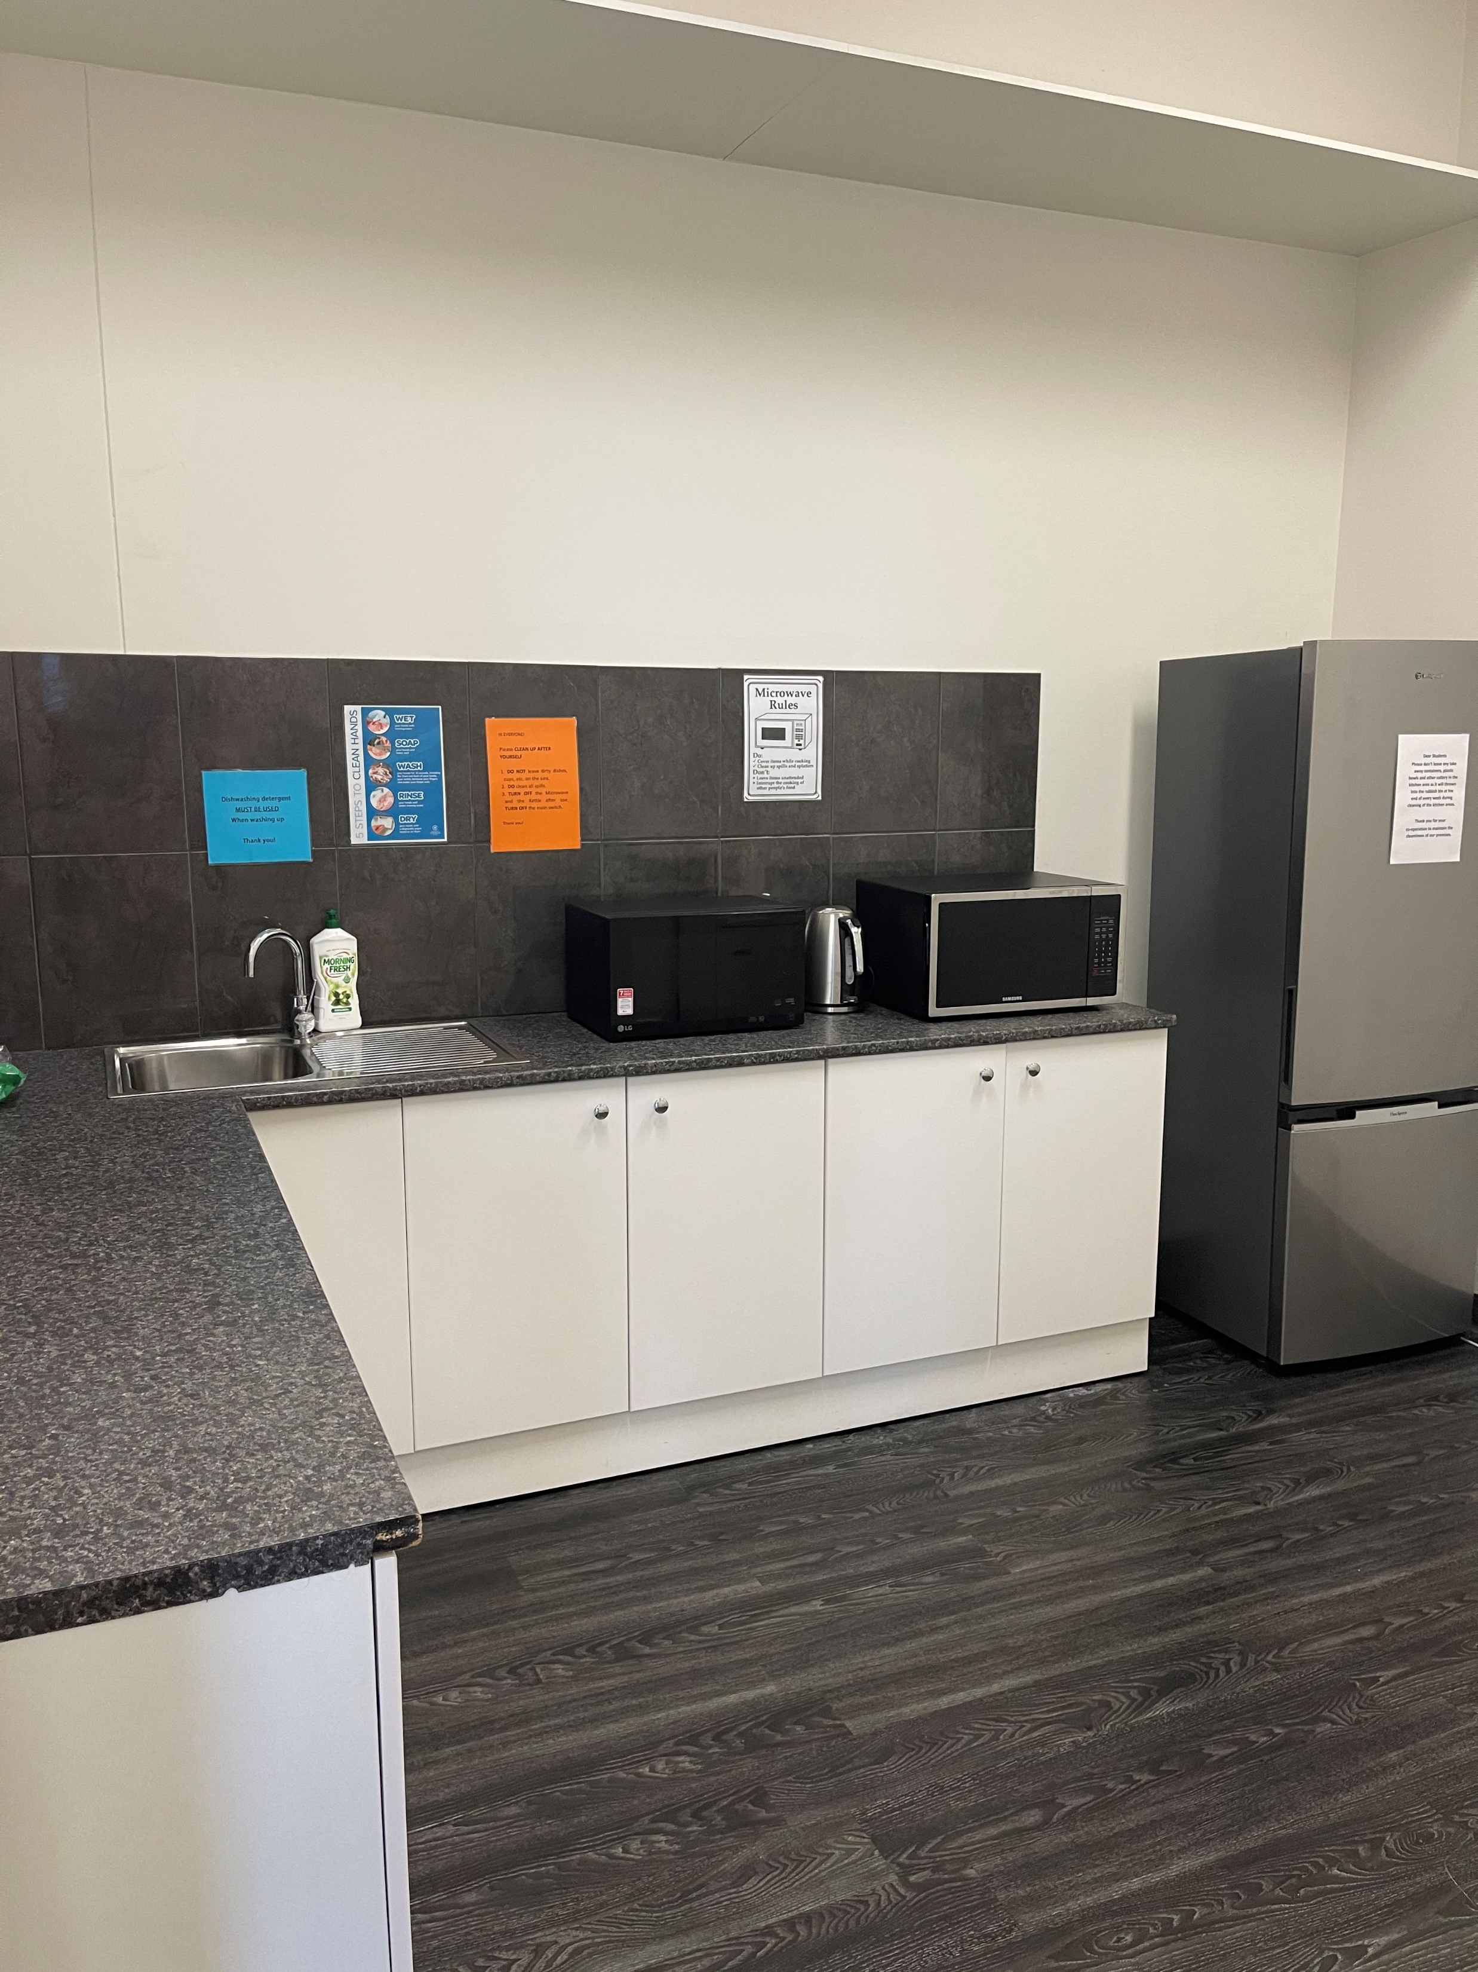
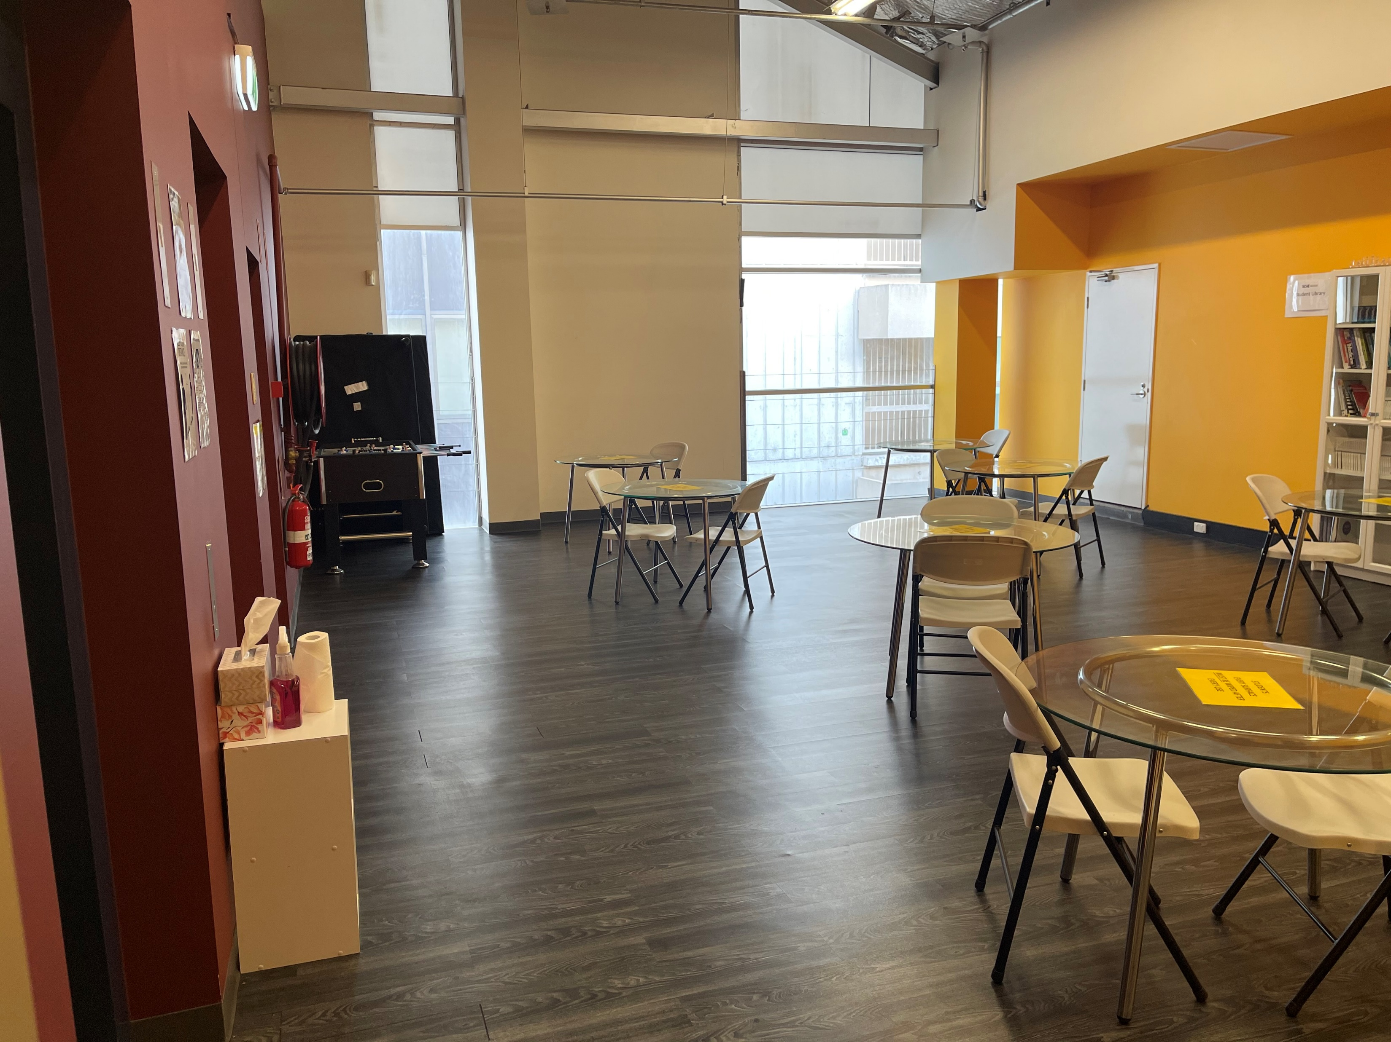
Resources
Reception & Printing:
Reception can assist you with general enquiries and appointment bookings with academic/student services staff.
You can also print your assessments or documents at reception. Simply send the document to reception_sa@scei.edu.au
* Printing prices: 10c Per Page (black and white) and $1 per page (colour)
Student Kitchen & Break Areas:
There are microwaves available on level 5 break area, and the student kitchen is available on level 5 .
Student Services Office
Located on Ground Level

Slide 10


Emergency Procedure
Alert Condition
"Beep, Beep, Beep'
Evacuation
"Whoop, Whoop, Whoop"
FIRE WARDEN
LEVEL 3: CAMPUS OPERATIONS
GROUND : STUDENT SERVICES OFFICER
TRAINERS ARE REQUIRED TO INFORM STUDENTS OF PROCEDURE IN EVACUATION
FIRE BRIGADE AUTOMATICALLY ALERTED
FIRE BRIGADE AUTOMATICALLY ALERTED
IF FIRE OR OTHER EMERGENCY IS ON YOUR FLOOR, ASSESS NEED FOR
EVACUATION. IF IN DOUBT COMMENCE EVACUATION.
FIRE WARDENS AND TRAINERS ARE TO IMMEDIATELY CLEAR ALL PEOPLE FROM THEIR FLOORS AND DIRECT FLOW OF PEOPLE TO FIRE STAIRS AND EMERGENCY EXITS.
STANDBY FOR INSTRUCTIONS FROM FIRE WARDEN AND EVACUATE WHEN ADVISED TO DO SO.
FIRE WARDENS PROGRESSIVELY CHECK ALL AREA ARE CLEARED EG. TOILETS
DO NOT USE THE LIFTS
PROCEED TO ASSEMBLY AREA
DO NOT USE THE LIFTS
PROCEED TO ASSEMBLY AREA
TRAINERS ARE REQUIRED TO USE ATTENDANCE ROLLS TO CHECK ALL STUDENTS HAVE ARRIVED AT ASSEMBLY AREA.

Slide 11
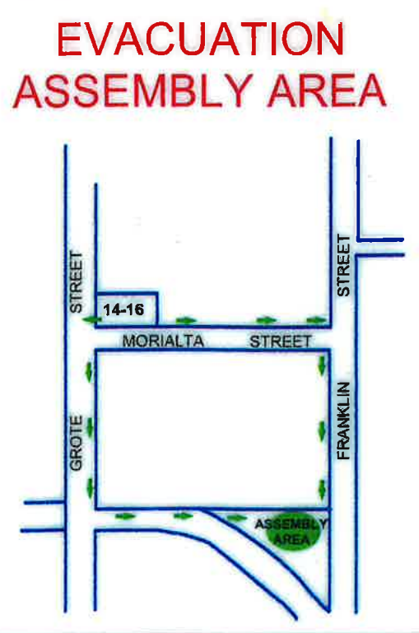
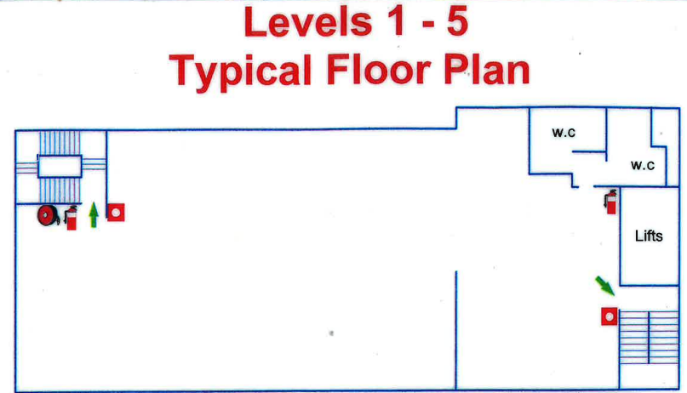
Evacuation Procedure

Slide 12






General Rules
Please see the PP79 Student Rules Policy for more information. Available via any staff member or www.scei.edu.au
Be kind to our environment
put your own rubbish in the bin please
Please report any spills or leaks
Please report any spills or leaks (HAZARDS!) to any staff member
We are a smoke and vapefree campus.
No smoking and vaping inside the premises – if you would like to smoke or vape outside please do not do so directly outside the front of the building
Respect the college and others around you!
Respect the college and others around you! We have a ZERO tolerance policy surrounding bullying or harassment. In Australia, bullying is a criminal offence.

Slide 13



Classroom Expectations
It is expected that all students and staff will be respectful of each other. Campus is a simulated work environment. It is expected that students will always dress and behave in a professional manner.
This means:
  Punctuality
  No food (including sweets) or drink to be consumed in the classroom (water is allowed) or the skill lab
  Mobile phones turned off or on silent and NOT answered or accessed during class time
  Allowing opportunity for others to speak
  Only leaving the classroom when the session is complete or as per trainer’s instruction
  Remain attentive and alert at all times
  Appropriate and clean clothing, SCEI prescribe uniform is compulsory for all skill lab session.
  Personal hygiene attended to daily

Slide 14

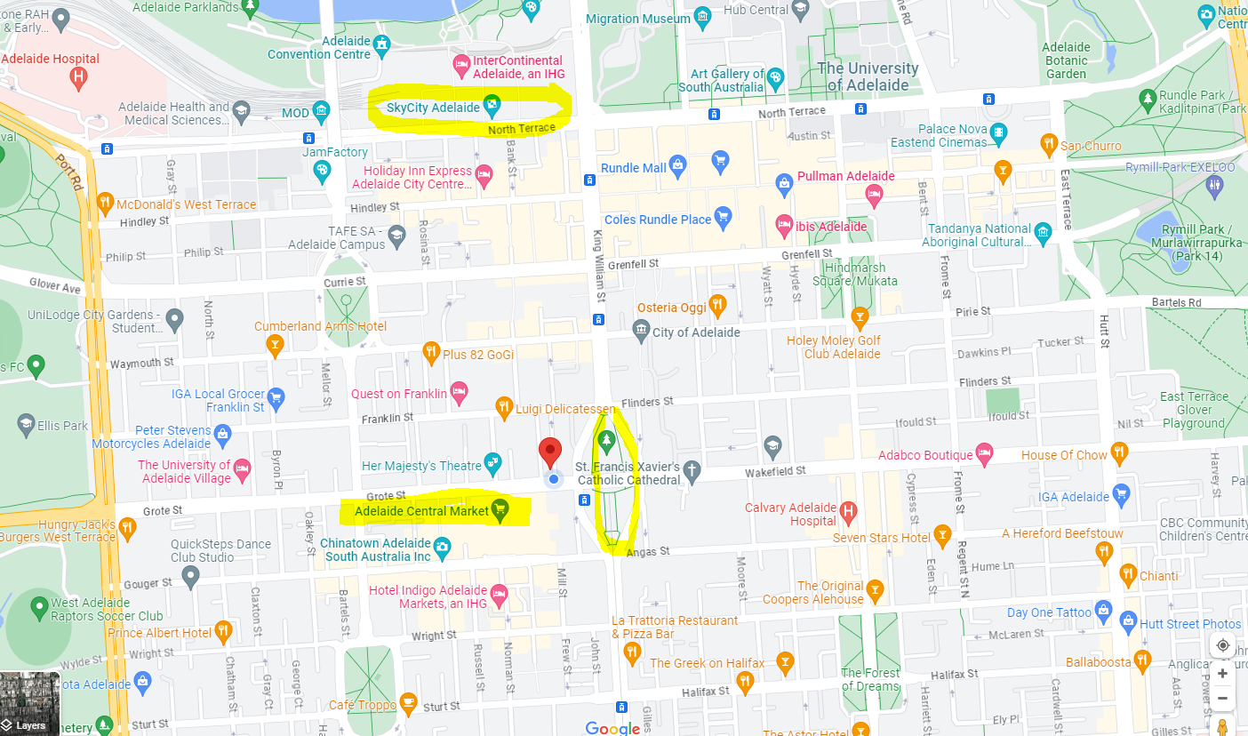

Parking and Public Transport
Parking: Parking at all campuses is street parking only (LIMITED). Ensure you lock your car, hide any valuables, and observe all parking signs.
Adelaide campus is close in proximity to public transport.
  1-minute walk to Tram stop (Adelaide entertainment center to Glenelg)
  5-minute walk to a lot of bus stops
  10-minute walk to main train

Slide 15


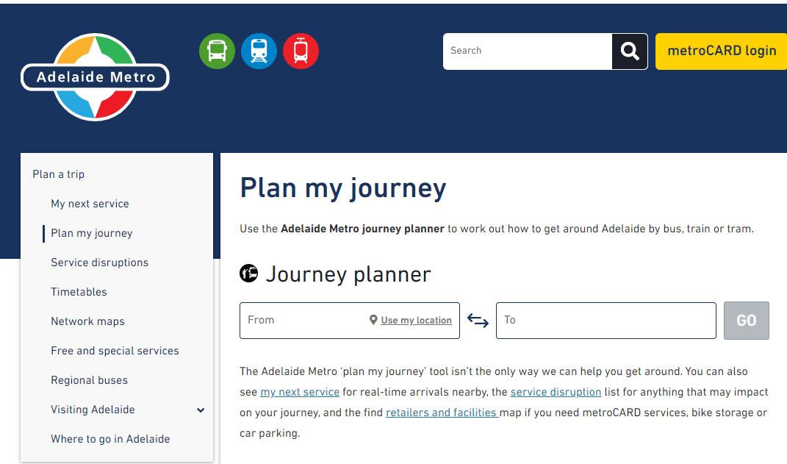
Public Transport
www.adelaidemetro.com.au
A good tip is to use the above website or mobile app to plan your journey with public transport in Adelaide.
Enter any address/stop/station you wish to depart from and your destination, and the adelaideMetro will inform you on how to get there the most efficient way.

Slide 16

Student Safety
In general, Adelaide is fairly safe (low pickpocketing and theft) but dangers do exist. See the below tips on safety:
  Looking down at your phone can prevent you from being aware of your surroundings, remember to stay aware and LOOK UP!
  Look up at the cars and trams when crossing the road – no headphones!
  Ensure you are aware of your surroundings on public transport. If you feel uncomfortable, stand up and move to another seat or carriage. The safest place to sit is in the first carriage or further up the tram (near the conductor) as there is more surveillance in these areas.
  Conceal large sums of money and highly valuable items on public transport (preferably, do not carry these with you at all).
  Do not leave belongings sitting around, keep them on you at all times when in public.
  If you are feeling unsure, ask someone around you for help.
In case of an emergency dial 000

Slide 17






Student Safety
In case of an emergency dial 000
Fire, Ambulance, Police
If it is not an emergency call the Police Assistance Line: 131 444

Slide 18

Beach Safety
HOW TO STAY SAFE @ THE BEACH
  Do not enter the water if you are under the influence of alcohol/drugs OR don’t know how to swim.
  Swim ONLY between the red and yellow flags where a lifeguard can watch you!
  Swim with friends
  Read and obey safety signs
  Be sun-smart - SLIP/SLOP/SLAP!

Slide 19


Punctuality
Plan your journey
Aim to get to campus 15 minutes prior to your lesson. If you are late, it will affect your projected attendance percentage and may result in receiving a formal warning letter.
Notes:
“If you are running late, you can email your trainer to let them know via your SCEI student email (which can be accessed via mobile)”

Slide 20

SCEI POLICIES

Slide 21

Attendance Requirements
All SCEI students must aim for a 90% attendance rate. However, the absolute minimum attendance rate is 80%.
If you are absent due to a compassionate or compelling reason, please email Student Services for your campus and your trainer explaining why. Attach appropriate evidence to this email so we can excuse your absence on that day.
  You are in breach of your student visa conditions if you do not have a compassionate or compelling reason explaining your absence.
  This includes travel without approval from Student Services.

Slide 22

Attendance Requirements
You will receive formal letters of warning if:
  You have been absent for 5 consecutive days without approval
  You are not attending classes consistently
  If your projected attendance falls below 80%
You will receive formal letters of warning and be required to have a meeting with Student Services if:
  Your projected attendance rate falls below 80%
Any student that falls below an 80% projected attendance rate will receive a letter from Student services informing them of SCEI’s intention to report the breach of visa conditions to the DHA.
Notes:
DIBP = Department of Immigration and Border Protection (Aust Gov)​

Slide 23
Preparation for Class
  This training program is delivered within a classroom environment; however, student are expected to undertake a level of self-directed learning which will assist your overall understanding and progression through the program.
  You are expected to dedicate 6-12 hours of self-study per a week for the completion of pre-reading readings and homework provided in class
  The content for self-directed learning is available in the student learning platform mySCEI.
  The self-directed learning may consist of:
    Compulsory pre-reading from the online textbooks, SCEI approved handouts or articles
    Website activities, researching topics and finding sources for assessments
    Watching prescribed videos and taking notes for classroom discussion
    Completing the online multiple-choice revision tests on MySCEI. These are not formal assessments, but a method used to monitor self-study, determine students’ level of knowledge and understanding, and identify areas for support and improvement.
  As an adult learner you are expected to complete all your prescribed self-study activities prior to each class. As adult learners, it is expected that you will take responsibility for your own learning. Trainers are here to facilitate your learning. It is up to you to make the most of all learning opportunities
  If you are flagged as not completing your self-study activities, you will be required to attend on a support day for supervised study on campus.
Notes:
Go into the first unit for group (usually HLTENN035 for DN) -> Go into Unit Overview and highlight breakdown of hours (Nominal hrs, classroom lecture hrs, skills labs, and self-directed learning)​

Slide 24

Assessment
  You will be assessed throughout the course in a variety of ways:
    Formative assessment occurs throughout the course in the form of skill demonstration, group work, completion of online self assessed quizzes, completion of the required pre-reading, discussions, role plays and scenarios. Formative assessment provides an indication of learning and consolidation and determines the student’s readiness for summative assessment.
    Summative assessment involves the collection of a range of evidence to determine the student’s demonstration of the required skills and knowledge of the unit. The combination of formative and summative assessments ensures the student demonstrates consistency of required skills and knowledge associated with the units of competency

Slide 25

Assessment Preparation
  To ensure you are adequately prepared for assessment process it is important that you are familiar with the all-assessment task relevant for each unit. This means:
    As part of your pre-reading before class, download each assessment task and save it into your OneDrive (included with your student email account)
    Read the assessment task and ensure you are familiar with them and have them open during each theoretical lecture. This way, you can quickly record notes against each task (as the trainers do cover the content during lectures)
    Take notes and revise before assessments and exams

Slide 26

Note-Taking – Tips and Tricks
It is crucial to develop a way for taking notes that works for you. Try a few ways out and see what you find comfortable and helps you remember what you learn.
Here are a few suggestions for ways to take notes:
  Give yourself time to write notes after class and during self-study, don't rush it
  Handwritten or typed – Whichever you prefer, stick to it
    Typing your notes in Microsoft Word (or Word Online using your SCEI student account) means you can spell-check, add images, and links to web pages
  Try the Cornell Note-Taking System to write down notes, questions you think of, and a summary of the topic
  Colour-code your notes (e.g., blue for headings, green for definitions, red for important information like due dates)
  Paraphrasing – Rewrite an idea in your own words (important to learn for referencing too)
  Use Mind Mapping - Make a diagram to visualise ideas and concepts that are related
Your trainers and Student Services are here to help if you would like advice and resources for note-taking and other study tips

Slide 27

Assessment Due Dates
  Assessment due dates are governed by PP77 Assessment and Submission Policy available on SCEI website as well as on the MySCEI portal.
  All theoretical assessment tasks are due 14 days after the last unit delivery
  All SCEI students must submit their assessments online via the MySCEI portal. Only PDF files are accepted, otherwise the assessment is marked 'Not Yet Satisfactory'.
    The trainer and assessor will discuss unit assessments with you on commencement of the unit and inform you of the due dates for each task.
    You are required to note the due dates in the space provided in the student assessment document. The due dates will also appear on your calendar in Moodle
      It also helps to add them to your personal calendar in your student email and set reminders
    Failure to submit the assessment by the due date will result in a $200 late submission fee
    Please note: Hard copies and email submissions are NOT accepted by trainers or Student Services.

Slide 28

Assessment Due Dates
  All evidence of practical skills assessment are due 48hrs after the assessment is conducted and should be uploaded to Moodle.
  * All practical skills assessment are within your student assessment task, located in MySCEI. You are required to print this document (double-sided) and get it collated / bound prior to your first practical skills assessment.
Notes:
It may be worth making recommendations on where this can be done (e.g., Officeworks)​

Slide 29

Extension to Assessment Due Dates
  If you are not able to meet the assessment due date, you do have the right to apply for extension by completing the FOR118 Application for extension for assessment due date located under the Student Support section of MySCEI platform.
  The FOR118 form MUST be submitted 48 hr prior to the due date via email directly to your trainer for approval.
  If and once approved the FOR118 form must be uploaded as a cover page with your assessment task.

Slide 30

Assessment Marking
Not Satisfactory VS Satisfactory
  All theoretical assessment work will be graded satisfactory(s) or Not yet unsatisfactory (NYS).
  1 Unit of Competency = 1 assessment. An assessment is usually made up of three different tasks.
  If you do not achieve a satisfactory(s) will be awarded the result of unsatisfactory (US) and will be provided feedback on the areas that need to be rectified.
  Based on the level of understanding demonstrated, you will be asked to address the gaps in your evidence by submitting part or all your assessment
  Should additional support be required it is the student’s responsibility to request additional assistance or clarification as soon as possible after receiving initial feedback.
  Total number of submission for assessment task is 3 times ( initial submission plus up to 2 resubmissions)

Slide 31
Assessment Marking
Not Satisfactory VS Satisfactory
  All theoretical assessment work will be graded satisfactory (S) or Not yet unsatisfactory (NYS).
  Should the result of unsatisfactory (US) be recorded on your 3rd attempt, you will be counselled by the Course Coordinator and provided options in regard to your continuance in the program based on your ability to meet the academic requirements.
  Options will include withdrawal or repeating the unit or semester at a cost. This decision will be based on the overall understanding you have demonstrated.
  If you have been deemed with an unsatisfactory result for a unit of competency linked to professional practice, you will not be allowed to participate in professional practice, until; you have achieved a satisfactory result in the relevant assessment.
  If you are deemed unsatisfactory on any professional practice you will not be allowed to progress onto the next semester. You will have to repeat the specific semester before being allowed to progress. The additional cost of this repeated semester is the responsibility of the student.
  For more information, please refer to PP77 Assessment and Submission Policy (available on MySCEI under Student Support).

Slide 32

Please note:
  All assessments need to be submitted in PDF format via the LMS (Learning Management System) with Study Platform MySCEI Moodle
  Assessments need to be individually submitted
If there are three tasks for a unit, you need to submit each task individually.

Slide 33

Assessment Submission & Record Keeping
Tips for Assessment Submission
  Make a calendar of due dates (e.g., Outlook Calendar, written reminders, spreadsheet, Trello, email yourself)
  Click Submit and always double-check your submission (open the PDF from the LMS portal)
  Be careful of “Drafts” – Make sure you have actually submitted for grading (Drafts do not count as submissions)
  Convert Word files to PDF using Microsoft Office (or Print to PDF)
  Double-check the correct task is in the correct portal

Slide 34

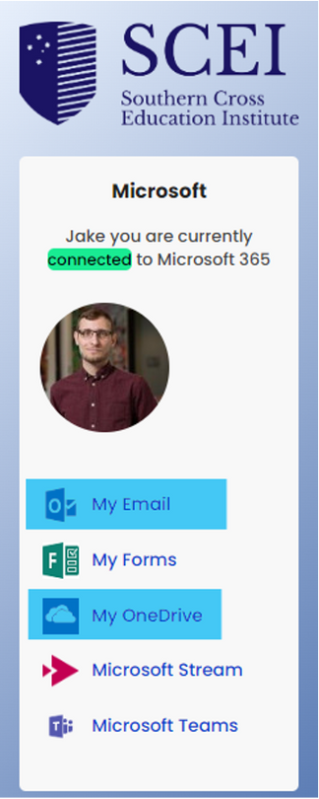
Assessment Submission & Record Keeping
Keeping a Record of Assessment Submissions
  Screenshot LMS page showing your submitted assessment and date
  Keep a copy of your finished assessments on your Microsoft OneDrive (log into MySCEI with your student account and click ‘My OneDrive’)
  We recommend Adobe Scan to scan documents on your phone
  Email Student Services and trainer ASAP about LMS access issues
  Also screenshot when technical issues come up as evidence
Prepare to show evidence of having submitted any assessment at any time.

Slide 35

Copying, Cheating & Plagiarising
Plagiarism: “The practice of taking someone else's work or ideas and passing them off as one's own.”
  You cannot present another person’s work as your own work by copying or reproducing it without acknowledgement of the source (referencing correctly).
  At Southern Cross Education Institute, the accepted style of referencing is APA 7th referencing.
  It is a form of intellectual property theft and unethical
TYPES:
Minor Academic Misconduct
Moderate Academic Misconduct
Major Academic Misconduct
More information can be found in our PP96 Academic Misconduct Policy and Procedure

Slide 36

Training and Assessment
Each week of training is approximately :
  two days face to face in a classroom (16 hours), plus an
  8-hour support class and
  approximately 6-12 hours of self-study per a week for the completion of readings and homework provided in class.
  If you are identified that you are not completing your self-directed study activities, you will be required to attend on a support day for supervised study.
  Each unit has a Unit Delivery and Assessment Guide which highlights what you should be doing for self-directed study before each session.

Slide 37

Credit Transfer
  If you have completed a similar qualification previously at SCEI or another college, you may eligible for a credit transfer which can save you time and/or money on your studies!
  Please fill in a FOR25 Credit Transfer Request Form emailed to you by our administration department (or on our website) and send it to the online@scei.edu.au. Please ensure to attach your academic transcript(s).
  If you need any help, you can discuss with our admin team or your trainer.
  This process should be completed either before enrolment or during the first week of your course.
  During the CT process, you are still required to attend all scheduled classes and participate in the practical skill assessment. You are not required to complete the theoretical assessment until your CT application is processed.

Slide 38

Academic Progression
SCEI is required to monitor a student’s course progress. We are sure you will try your best, but those students who do not maintain satisfactory course progress without seeking assistance, will be at risk of receiving a warning letter.
First Warning Letter:
  Failing a prerequisite unit;
  Academic progress falls below 50% of the Semester.
  You will be asked to meet with Student Services
Intervention Plan
Second Warning Letter:
  Failing to adhere to the intervention plan.
  Failing a prerequisite unit;
  Academic progress falls below 50% for the Semester
Final Warning:
  Intention to Report Notice
  Academic progress falls below 50% in two consecutive study periods.

Slide 39
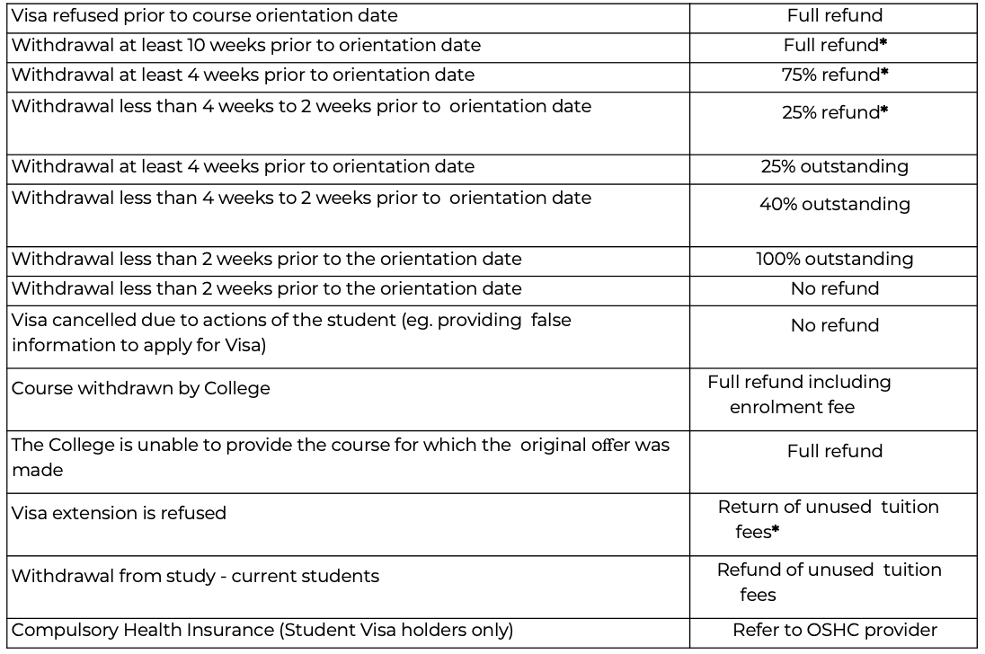

Refund
For More Information, please read the
PP05 Refund policy and procedure

Slide 40

Suspensions, Deferrals and Cancellations
Things happens, if you need support, please email Student Services
Students are only eligible for a suspension, deferment or cancellation due to the compassionate or compelling reasons
  Mental health issues
  Illness
  Maternity leave
  Experiencing or witnessing of a serious accident/crime
  Care for an immediate family member who is suffering long-term or terminal illness
  Visa delays
  Change of visa
* Please note that supporting documents must be provided.
** International students may experience issues if they do not have their suspension approved before leaving the country.
For more information, please refer to PP16 Deferring, Suspending, or Cancelling Student Enrolment Policy and Procedure

Slide 41
Penalty Fee Or Other Charges
Registration Fee – Non-refundable
$300.00
Late Payment of Tuition Fees / Payment Plan Late Fee Penalty*
$200.00
Fee for revision of payment plan (Per each revision)
$100.00
Penalties for late assessment submission (Per unit)
$200.00
Reassessment Fee
$200.00
Change of course request
$300.00
CoE Extension
$300.00 Admin fee +
Cost per week of extension (varies based on course
Change of course request also means change of course plan – such as deferment due to your personal reason (not compassionate reason)
If you do have compassionate reason or other reason you believe need to be considered, please book an appointment with Student Services
Late Submission Penalty
If you did not submit your assessments by the due date, you will be emailed by your designated Student Services Officer.
  You will need to clear out the penalty fee before you can resubmit the work
  This rule is implemented to encourage students to hand in work ON TIME!

Slide 42

Complaints & Appeals
  SCEI will always strive to resolve any issues as soon as possible. This may involve a meeting, discussion or general mediation in relation to the issue.
  If this is unsuccessful, students can lodge a formal complaint by filling in a FOR03 Complaints and Appeal Form found at reception and scei.edu.au
  This form may be used to complain about an issue that has not been resolved by SCEI, or to appeal a decisions SCEI has made that you may feel unfair.
  Remember that we are here to help – so please come and see us if you have any concerns.

Slide 43

Vaccination Requirements
All students in SCEI must follow and meet the vaccination requirements of your course.
These requirements will determine eligiblility for work placement. They may include and are not limited to:
  Varicella (Chicken Pox)
  TB (Tuberculosis)
  Rubella
  Measles
  Mumps
  Polio
  Hepatitis (B and possibly A)
  COVID-19 (minimum 3 doses)
  Flu (annual flu shot)
  Pneumonia (depending on health requirements)
Speak to a doctor if you are missing any vaccinations ASAP. You are required to upload a vaccination history for most courses. Contact Work Placement Officer for further instructions

Slide 44

Textbooks
All students in SCEI who have attended the first day of orientation will receive the codes to access their online textbooks.
Please refer to Student Handbook and to each Unit of Competency UDAP (unit Delivery & Assessment Strategy)

Slide 45

Nursing Kits
It is mandatory for all students studying the Diploma of Nursing to have a nursing kit for practical and simulated lab sessions.
The cost of the nursing kit is not included in your fees.
Each student must purchase the following items by no later than the first month of your course:
Safety Glasses Radar - Clear Lens
Laerdal Patient Face - Shield Key Ring
Spirit CK-S601PF-R Stethoscope Classic Finish
Spirit Retractable Badge Holder with Poly Sticker Frosted
Spirit - Hard Plastic Badge Holder Portrait
3 Colour Red Grip Plastic Ball Pen
Sphygmomanometer
Nursing Pocket Pouch with Navy Stitching
Spirit -Soft Plastic Badge Holder Portrait
Penlight Instrulite Chrome LED Bulb
Nursing Fob Watch Silicone
These can be purchased through Medshop Australia or Enurse
Medshop Australia - https://www.medshop.com.au
Enurse - Nursing Supplies - Australia's Leading Online Nursing Equipment Shop

Slide 46

How to Email Us
When you email us, please put the following information in the subject line:
  SCEI Student ID number
  Your full name
  Your course name
  What you wish to discuss
  (ie. 12345 John Smith, Diploma of Nursing - Course Suspension)
We will not respond to any emails if:
  They are sent from your personal email address
  They are sent to our individual emails instead of Student Services
  The email does not include a subject line
  Your query has already been received and is in process
  Subject line: 12345 John Smith, Diploma of Nursing - Course Suspension
  Please use your student email accounts to contact us whenever possible – Otherwise it may end up in our spam filter

Slide 47

HAVE A STRETCH!

Slide 48

LMS & Student Email Tour
Notes:
Go through FOR28 Change of Personal Information form on LMS -> Submission portal on Orientation to be made and students to go through filling out and saving PDF (using Print to PDF) during orientation

Slide 49
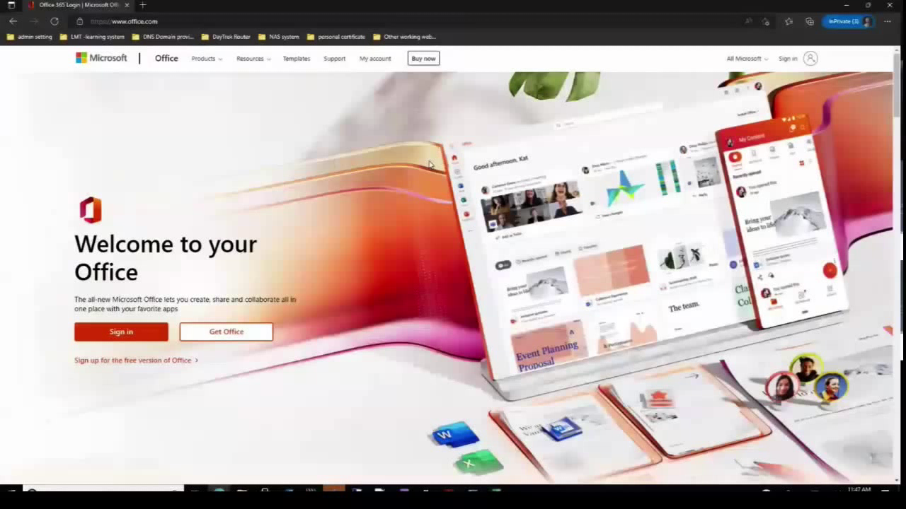

Slide 50
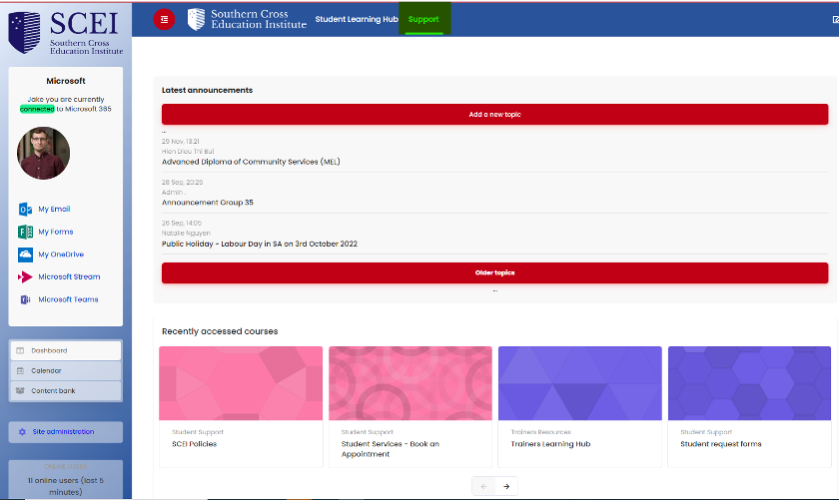
LMS and Student Forms
  Log in to your LMS home page
  Click ‘Support’ in the heading
  Select 'Student Policies and Forms‘
  Click 'Enrol' to self-enrol into the process
  Select 'Student request forms' or 'SCEI Policies‘
  Download the relevant form PDF.
  Email your completed form to the correct team according to the directory.
  Please note you must discuss any deferments, cancellations, suspensions, COE extensions, campus and course changes with Student Services prior to applying.
  We may not be able to process these requests without discussing and/or meeting with Student Services first.

Slide 51

Emailing Procedures
  We will do our best to respond to your email within 7-10 business days
    That said, we do get very busy periods so please be patient and bear with us
  We will process your applications within 10-15 business days.
  Please note, you must contact SCEI staff using your student email address (ie. SAXXXX@scei.net.au)
Student Number
NOT .edu.au - that's for staff

Slide 52

REFERENCING & PLAGIARISM
(7th Edition)

Slide 53
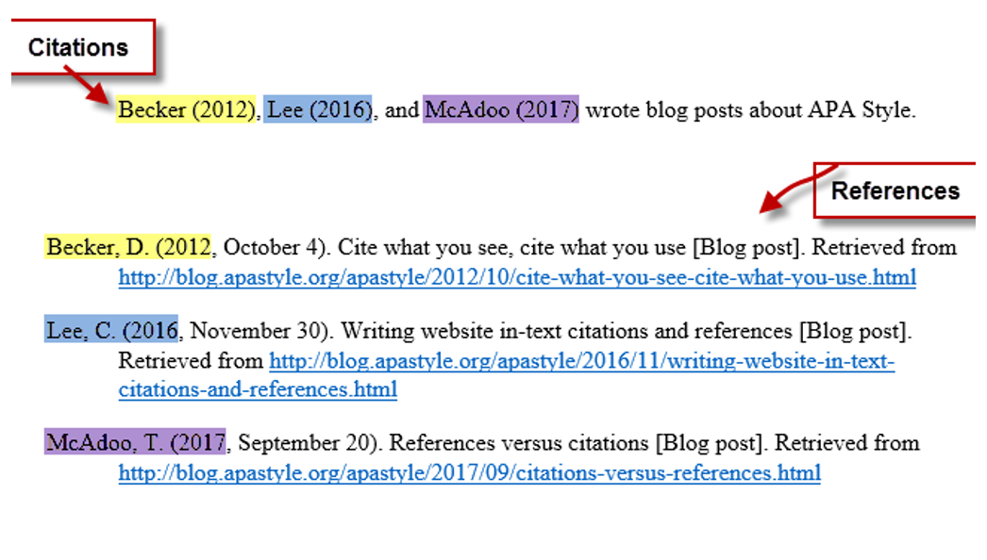
REFERENCES & IN-TEXT CITATIONS
Reference List

Slide 54
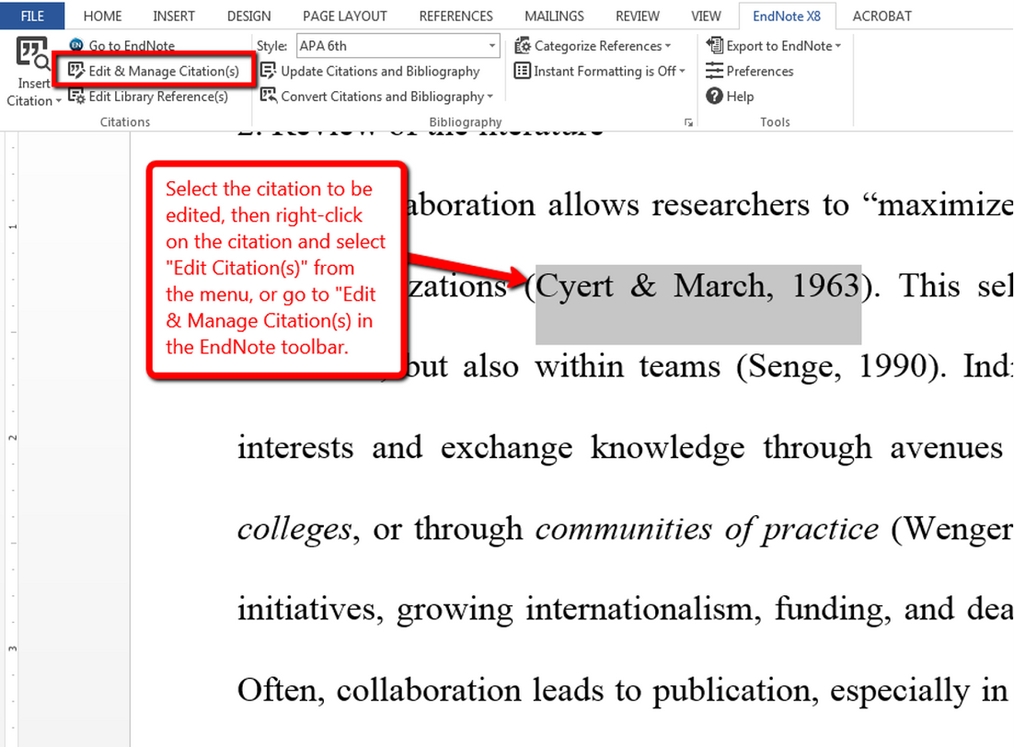
IN-TEXT CITATIONS
In-text Citation

Slide 55

Helpful Websites
REFERENCING MODULES (LA TROBE UNIVERSITY):
http://www.lib.latrobe.edu.au/elearning/referencing/index.html
APA 7TH REFERENCING:
https://latrobe.libguides.com/apa7
QUOTING & PARAPHRASING – APA STYLE
https://apastyle.apa.org/style-grammar-guidelines/citations/quotations
https://apastyle.apa.org/style-grammar-guidelines/citations/paraphrasing
GRAMMARLY PLAGIARISM CHECKER
https://www.grammarly.com/plagiarism-checker

Slide 56

QUICK CHECK!
  Have you tried to access your student email?
    Check for an email from the Admin/Enrolments team – It'll have a date that your email address is active on, your student email, and default password (sceiVET123)
  Tried to log into LMS?
  Do you have your training plan (class schedule)?
  Do you know your student ID number?
  Have you sent your Enrolment Data Form back (form with your details)?
IF NOT, SEND IT TO online@scei.edu.au ASAP

Slide 57


Slide 58
See Student Services for a confidential chat...
  Bullying
  Mental & physical well-being
  Time-management advice
  Academic support
  Basic legal advice
  Dealing with stress
  Dealing with depression
  Dealing with homesickness
  How to study effectively
  Your dedicated Student
  Support Service Officers and Counsellor are here to assist you in all areas of confidential needs

Slide 59





Useful Wellbeing Numbers and References
Beyond Blue
Advice & support for anxiety and depression.
1300 22 46 36
1800 Respect
Confidential information, counselling & support service for those impacted by sexual assault, domestic/family violence & abuse.
1800 737 732
Kids Helpline
A free, private, confidential, telephone & online counselling service for young people aged between 5 & 25.
1800 55 1800
Butterfly Foundation
Advice & counselling for people experiencing eating disorders and their carers.
1800 046 698
Lifeline
Crisis support and suicide prevention.
13 11 14

Slide 60

Get involved

Slide 61

LET’S GET TO
THE FINISH LINE
TOGETHER!!

Slide 62

Thank You

